Slide 1
Map of africa
Using colored pencils and page 777 in your textbook
Color code map of Africa on page 47
Be sure to create a key

Slide 2
Review Questions
What were the four causes of Imperialism?
Nationalism, social Darwinism, Military reasons, economic reasons
What caused the scramble for Africa?
King Leopold II annexing Belgian Congo
What was the result of the Berlin Conference?
European Countries divided Africa amongst themselves, no concern for Africans
Identify one way the Europeans were able to prevent African revolts
Diseases, play on ethnic rivalries, boundaries, better weapons

Slide 3
Agenda
Bellringer
Review Questions
Notes: Imperialism in China
Exit Ticket
**Quiz Tomorrow*

Slide 4
Review Questions
What was the Sadler report?
Parliamentary hearings on labor violations, child labor
What legislation was passed as a result of the Sadler report?
Factory Act 1833
What was the scramble for Africa?
Industrialized countries all fighting over imperializing Africa
What was the result of the Berlin Conference?
Europeans countries divided Africa amongst themselves
What is social Darwinism?
Idea that helping “less fortunate, uncivilized” peoples become “civilized” was a duty of European countries

Slide 5
Objectives
Students will identify the causes and effects of the opium war and the Taiping/Boxer rebellions by writing a paragraph

Slide 6
Imperialism in China

Slide 7
China

Slide 8
China

Slide 9
Historical Circumstance
China was Isolationist – they did not care to interact with the rest of the world
Why?
Ethnocentric due to geography
There was a high demand for Chinese goods in Europe, but a low demand for European goods in China

Slide 10
Motivation
Europeans wanted to establish more markets in China to sell goods, but Chinese didn’t want it
Chinese had based their economic system on silver, British economic system based on gold
How can trade be accomplished when there are two different currency standards and one side doesn’t want anything?

Slide 11
Solution
Get the Chinese people hooked on opium
“Get em high and get their money”
Chinese government not thrilled that Europeans were getting their people addicted to Opium

Slide 12
Opium
Derived from the poppy plant
Currently is chemically processed to produce heroin
Highly addictive

Slide 13
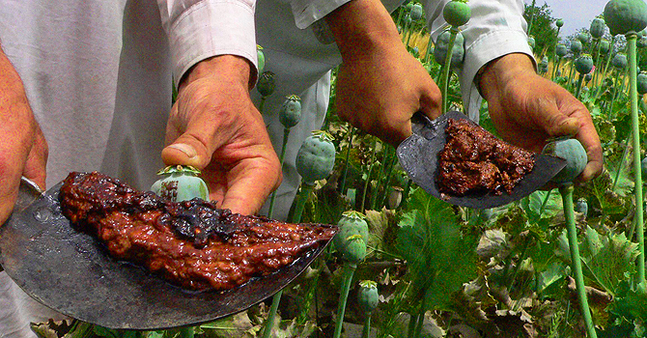
Opium

Slide 14
Opium
The British basically gave opium to the people of China
After they were addicted they jacked the price
Estimated 12 million Chinese addicted
Productivity dropped, government angry, wanted the British gone

Slide 15
Qing Emperor to Queen Victoria
“By what right do you use this poisonous drug to injure the Chinese people? I have heard that the smoking of opium is very strictly forbidden by your country; that is because the harm caused by opium is clearly understood. Since it is not permitted to do harm to your own country, then even less should you let it be passed on to the harm of other countries?”
Sent by Lin Zexu

Slide 16
Opium War
1839
Opium war between China and Great Britain
Mostly took place at sea
China’s outdated ships didn’t stand a chance against British steam powered gun boats
China easily defeated
1842 signed Treaty of Nanjing

Slide 17
Treaty of Nanjing
Great Britain got Hong Kong
China had to pay Britain’s war costs (Reparations)
All Chinese ports had to be open to British trade
Gained extraterritorial rights for British citizens – not subject to Chinese laws
Chinese will grow to resent both foreigners and their opium

Slide 18
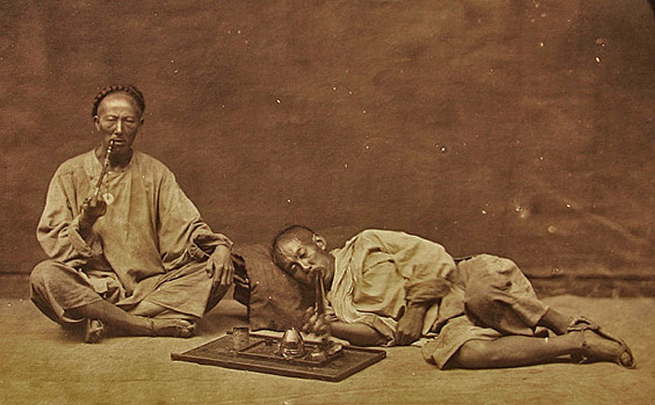

Slide 20
Taiping rebellion
Chinese population skyrocketed 30% in only 60 years
Food production remained stable
Not enough food = poverty, anger, resentment, crime, corruption
People began rebelling against Qing Dynasty (lost the mandate of heaven)

Slide 21
Taiping rebellion
Taiping means “Great Peace”
People wanted to equally distribute China’s resources to be more fair (sound familiar? )
Taiping army reached 1 million, they captured the city of Nanjing and declared it the capital
Weak leadership resulted in collapse of the Taiping government, 20 million people died

Slide 22
Boxer Rebellion
Chinese were embarrassed by their loss in opium war, the heavy influence of foreigners, their weak government – anti-imperialist
Frustration and embarrassment led to violence
Poor people revolted against imperialists and Chinese Christians (thought they were sell-outs)
Formed a secret society called the Society of Righteous and Harmonious Fists

Slide 23
Boxer rebellion
Nicknamed the “Boxers”
Surrounded foreigners in Beijing, kept city for several months
European powers defeated Boxers
Result: even though they lost, a strong sense of nationalism was established

Slide 24
Exit Ticket
Write a paragraph in which you summarize the cause and effect of one of the following events in China:
1. Opium War
2. Boxer Rebellion
3. Taiping Rebellion

