Slide 1
Green Roofs
Auston Reed

Slide 2
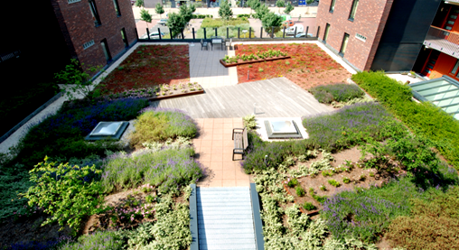
Semi-Intensive Green Roofs

Slide 3
What it is
A semi-intensive green roof system is characterized by small herbaceous plants, ground covers, grasses and small shrubs, requiring moderate maintenance and occasional irrigation. A typical growing medium depth for a semi-intensive green roof is 6 to 12 inches. This system is able to retain more storm water. Though higher in maintenance, this green roof system also provides the potential for a formal garden. Average weight per square foot is 25- 40 lbs/ft².

Slide 4
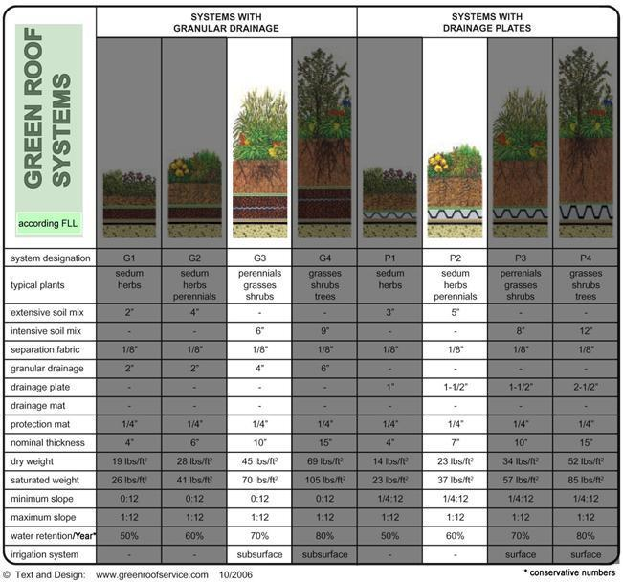
Types of Plants

Slide 5
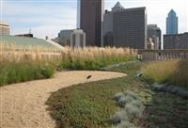
Library Examples
The Philadelphia Public Library features a semi-intensive green roof with an accessible patio open to the public. The green roof utilizes a granular drainage system and supports a multitude of sedums, herbaceous plants, and ornamental grasses.

Slide 6
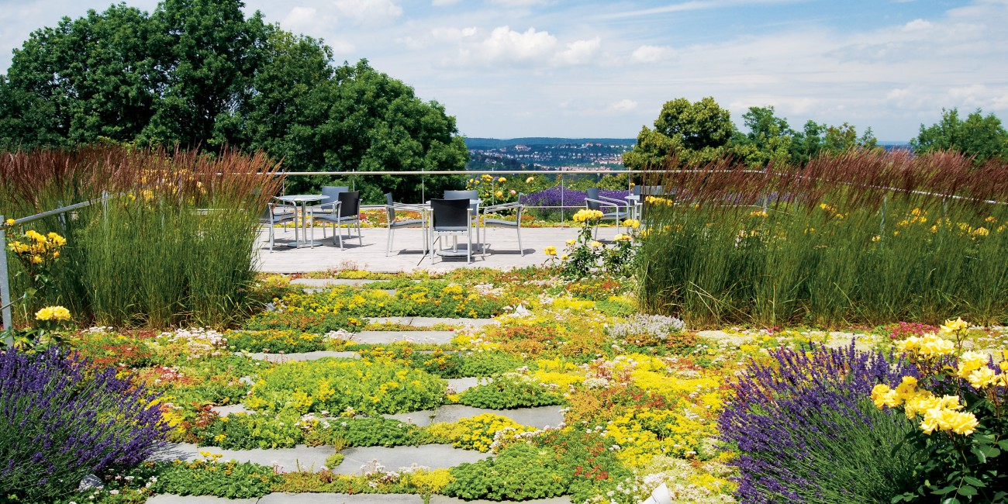
Extensive Green Roofs

Slide 7
What it is
An extensive green roof system is characterized of its vegetation ranging from small grasses, herbs, and flowers. They need little maintenance and no permanent irrigation system. The growing depth for an extensive green roof system is typically 6 inches or less. These systems are ideal for efficient storm water management. Extensive green roofs are very cost efficient. The average weight per square foot is 15- 25 lbs/ft².

Slide 8
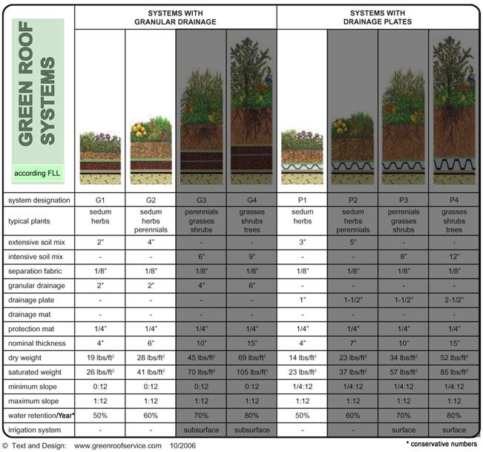
Types of plants

Slide 9
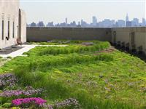
Bronx County Courthouse
The Bronx County Courthouse features a 1 inch drainage layer with a 2.5-3 inch deep growing medium profile. The green roof is composed of a mix of sedums and hardy herbs, with a sweeping crescent of small grasses. Despite the 10 story elevation and center city location, the green roof has attracted a variety of wildlife over the years.

Slide 10
Intensive Green Roofs

Slide 11
What it is
An intensive green roof system is characterized by its variety of vegetation ranging from herbaceous plants to small trees with professional maintenance and advanced green roof irrigation systems. A typical growing medium depth of an intensive green roof is 6 inches or more. This system supports everything from small personal/home gardens to full scale public parks. Plant selection and design greatly affects the maintenance required for the upkeep of these roofs. Rooftop farms, urban roof farms or vegetable farms on roofs are clearly intensive green roofs and require higher nutrient applications and focused maintenance. The average weight per square foot is 35 - 80+ lbs/ft².

Slide 12
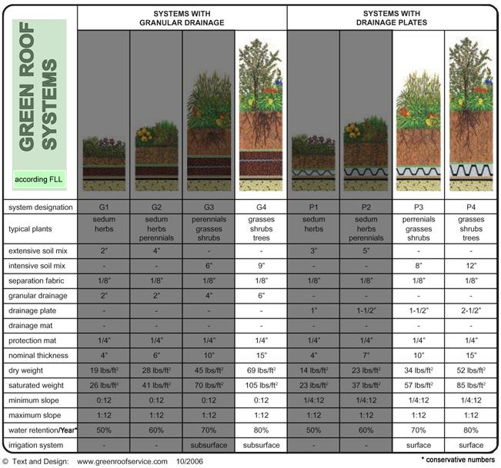
Types of plants

Slide 13
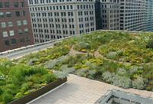
Chicago City Hall
The Chicago City Hall green roof profile ranges from 4 inches to 2 feet in depth on a Geofoam landscape. This roof amply supports over 150 plant species, including woody shrubs, vines and trees. The plants were selected for their hardiness, native origins and their hardiness to the extreme temperatures and wind of the city by Landscape architects. Jörg Breuning consulted this project in all regards and developed Green Roof solution tailored for this unique location - and the first green roof in the USA according modern green roof technology.

Slide 14
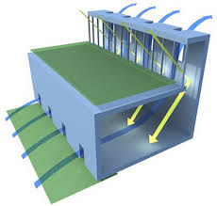
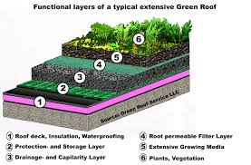
Possible design for the Library

Slide 15
The design
Walk way

Slide 16
The design
This design is a Extensive Green which has high grasses and shrubs. The average weight is 15- 25 lbs/ft² so it is not overly heavy. I chose this design because it could give some shade from the grasses and would be nice for an out door reading area with these types of plants. It is also low maintenance.

Slide 17
Works Cited
http://www.greenrooftechnology.com/extensive-green-roof

